Slide 1
SAR (SYNTHETIC APERTURE RADAR)
ALISHA JOY A

Slide 2
TASK -1
Conceptual Understanding: Gained a comprehensive understanding of radar imaging, speckles, and image properties through extensive review of research papers and references.
Implementation: Initiated the implementation phase by applying various filters for despeckling radar images.
Data Acquisition: Derived Synthetic Aperture Radar (SAR) images from the Copernicus website.
Data Processing: Processed the SAR images using the SNAP software, converting them into multiple formats for analysis.
OUTPUTS :
SAR_de-speckling_angstromers/kaggle_try.ipynb at main · AlishaJoy/SAR_de-speckling_angstromers

Slide 3
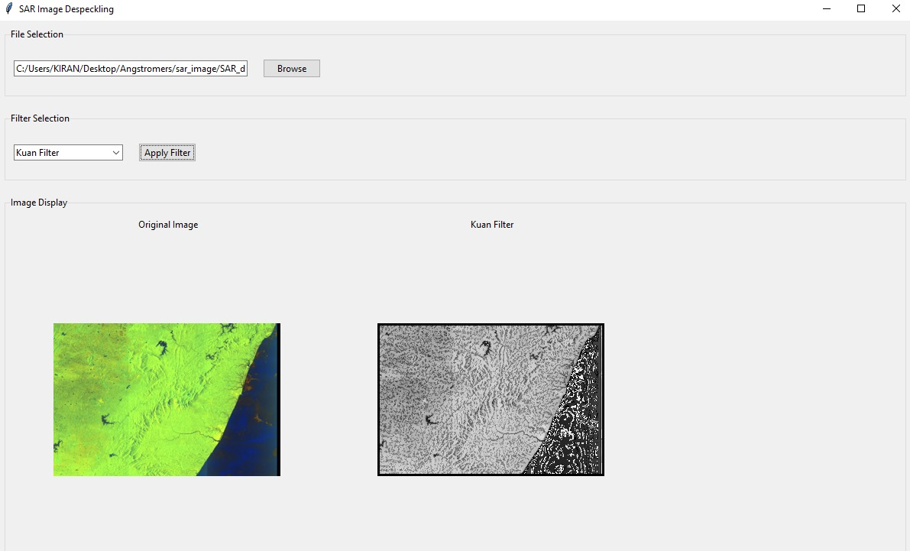
SAR_de-speckling_angstromers/GUI_outputs at main · AlishaJoy/SAR_de-speckling_angstromers

Slide 4
TASK – 2
Foundational Knowledge: Acquired a thorough understanding of the basics of image processing.
Research Implementation: Tasked with implementing the SAR2SAR semi-supervised algorithm for despeckling, as detailed in a specific research paper.
Algorithm Efficiency: Demonstrated that despeckling using the SAR2SAR algorithm is more refined and efficient compared to other methods.
Validation: Utilized image metrics code to validate the efficiency of the despeckling process.
Currently I am still working on the same with other type of SAR image inputs .
SAR_de-speckling_angstromers/Kiran_Copy_of_File1_SAR2SAR_GRD_test.ipynb at main · AlishaJoy/SAR_de-speckling_angstromers
SAR_de-speckling_angstromers/Results_sar2sar(one).docx at main · AlishaJoy/SAR_de-speckling_angstromers

Slide 5
